Slide 1
Privacy Recommendations for Future Distributed Control Systems
Master's Thesis Presentation
By Wasfi Momen
Committee Members: Dr. Yubao Wu and Dr. Ashwin Ashok
Advisor: Dr. Anu Bourgeois
Date: July 19th, 2019

Slide 2
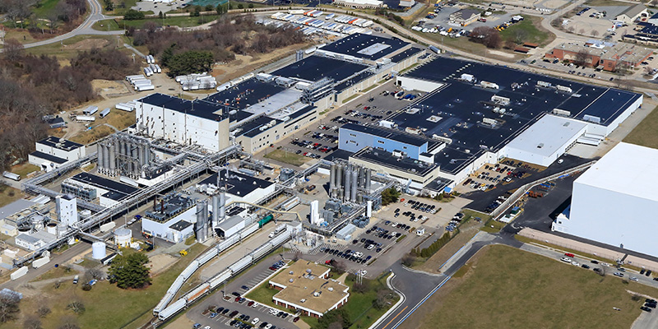
A Common Story...
Toray Carbon Fibers America
Carbon fiber manufacturing plant in Morgan County, Alabama. Produces military-grade, export restricted carbon fiber.
Notified by Homeland Security in 2014 about network traffic leaving the plant to China, which is on the denied countries list. Turns out there were severe security vulnerabilities in the Yokogawa Data Historian.
Resulted in strengthening of security policies and long-term investigation. Led to arrests of multiple individuals trying to get fiber samples or trade secrets.

Slide 3
Historical Setup
Focus on security culminated in the 70s and 80s with the development of tools and major research.
Key factor: Government Funding
Government Money => Industry Interest
NSA prizes for encryption
Jump to the post-cloud 2010 era, security catch-up.
Now, history repeats itself with privacy
Research focusing efforts on privacy technology
Government working groups for standards development (NIST, DoE)
Expanding from control security to data privacy

Slide 4
Developing a Privacy Framework for DCS
With knowledge of current standards and privacy-preserving technology, we propose standard modifications to create a privacy framework that can obfuscate, disclose,or otherwise protect the data within industry requirements.
Assumptions
Use general standards of DCS, not industry-specific.
Not including deep questions about privacy, just relating privacy to other used DCS protections like security.

Slide 5
What is a DCS?
DCS = Distributed Control Systems
Differs from ICS (Industrial Control System) and SCADA (Supervisory Access and Data Acquisition).
Control system: produces a response based on controlling output
Engineers track the output of a process variable PV (e.g. temperature) to modify machinery switches to produce output. Set point SP is the target that engineers want to maintain.
A DCS plant controls many automated responses and processes
Plants have central databases that machines report to—the data historian.
All DCS are based on the IEC 62443 / ISA99 standard.
Notes:
ICS is the superset term in which SCADA and DCS can be under. SCADA can be inside DCS, but honestly confusing terminology. More info here: http://oro.open.ac.uk/54687/1/594090.pdf
Toilet example: Your toilet is a control system. Flush, fill till level, stop and wait

Slide 6
IEC 62443 / ISA99
Level 4 Business Planning
Level 3 Manufacturing Operations Management
Level 2 Supervisor Control and Monitoring
Level 1 Sensor Level Feedback
Level 0 Physical Process

Slide 7
DCS Plant
Data Historian
Temp. Sensor
Boiler
PLC
HMI
* OPC-UA link

Slide 8
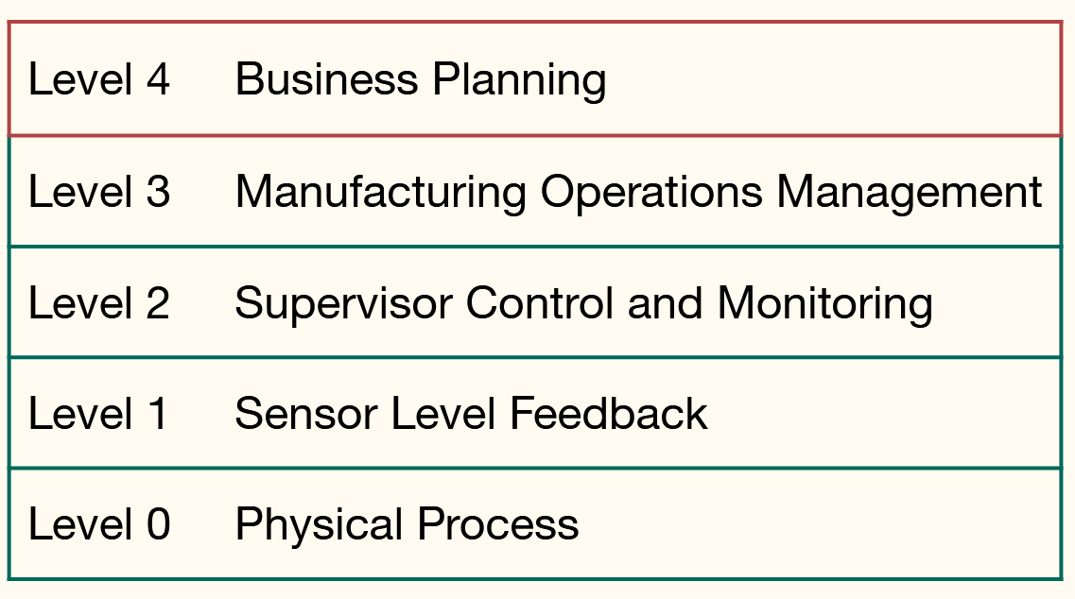
Modern-Day DCS
DCS1
Data Historian
Temp. Sensor
Boiler
PLC
HMI
DCS2
Cloud Interface
Data Historian
Temp. Sensor
Boiler
PLC
HMI
Corporate Office

Slide 9
Standards of DCS
Provided for interoperability, reliability, and security of DCS.
"Design first, secure later"
Continuous development and merging between different organizations
NIST, ISA, IEC
Most standards have measures of security.
Now, need to add privacy recommendations to all of them within the McCumber model.
Note that standards mention the Smart Grid industry as a key example for protections.

Slide 10
IEC 62443 / ISA99: Security for Industrial Automation and Control Systems | Specifies the various relations and operations of a DCS. This includes the relationship of business to manufacturing, formal nomenclature, and the DCS as a 4-layer model.
IEC 62541: OPC Unified Architecture | Specifies the OPC-UA architecture, the most widely used protocol for modeling relationships within a DCS. Matches a server-client model with standard headers and fields for device interoperability. The OPC-UA architecture manifests the logical and physical relationships established by IEC 62443/ISA 99.
NISTR 7268: Guidelines for Smart Grid Cybersecurity | A three-paper set of guidelines in cybersecurity for critical infrastructure made in 2014. Specifically has a whole section devoted to privacy,but mainly in a Smart Grid context. Defines privacy only as it ”relates to individuals” through 4 social dimensions. Data ”in-transit” and ”at-rest” are discussed as part of Category PR.DS-P”Data Security” in a 2018 report detailing improvements to the initial privacy specification

Slide 11
Model of Security
CIA triad
three defining concepts: confidentiality, integrity, and availability.
Parkerian Hexad
added concepts such as authenticity, control, and utility.
In past research, there were also many different "best practices" of security like least privileges and defense in-depth.
Confidentiality
Parkerian Hexad
Confidentiality
Availability
Integrity
Availability
Authenticity
Possession
Integrity
Utility

Slide 12
Confidentiality
Parkerian Hexad
Confidentiality
Availability
Integrity
Availability
Authenticity
Possession
Integrity
Utility
Security Principles
Security Protections for DCS

Slide 13
Model of Privacy
Privacy principles are still being detailed.
Some widely-sourced principles: Privacy by Design by Ann Cavoukian
Full understanding of concepts yet to be implemented.
Are there any models that detail privacy?
McCumber Cube Model
Differences of security and privacy within networks and systems
Control plane vs data plane
Unclear about where confidentiality lies
Focusing on privacy means dealing with data transmission, storage, and processing.

Slide 14
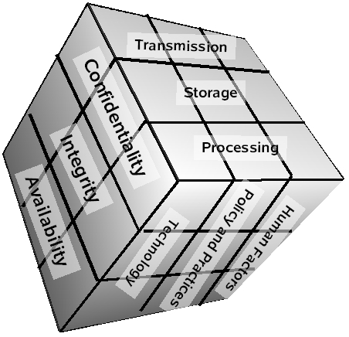
McCumber Cube Model

Slide 15
Privacy
Standards
Holistic view of DCS protections
Future Privacy Development
McCumber Model
Privacy Preserving Technology

Slide 16
Differential Privacy
Considers two databases & exchanged data records
Two databases differ at most one data record.
Attacker wants to know if data record is from one database or another
How to protect?
Add noise to the data records via randomized mechanism.
Goal is to make it seem data record never existed.
Using privacy budget ε, we can add more and more noise to give better privacy at the cost of utility.

Slide 17
Data Records
Randomized Function
Noisy Data Output
?
1 0 1
0 1 0
0 0 1
.1 .1 .1
.1 .1 .1
.1 .1 .1

Slide 18
Differential Privacy in DCS
In DCS, differential privacy (DP) can be applied on sensors and the data historian to protect the data values being passed between the two.
For example, a smart grid gathering information on power demand will practice a DP protocol to protect the data being received.
Aggregate data will be noisy, but can produce a close-to-truth value to produce as a set point SP.
Attackers will not know the actual true values of power demand, and won't be able to learn about user habits.

Slide 19
Problems of Differential Privacy
Known attacks
False data injection attackers
Randomized value
Costs of privacy
Loss of utility
Some industries might not be able to handle
"Engineering Units"
Developing Protections
Better algorithms to provide random noise vs utility tradeoff
This week's development: Sensitivity Conjecture
Notes:
FDI try to match prob of false alarm and their attack
Sensitivity Conjecture is used for uncertainty of bits: trying to figure out bits flipping 0 or 1. But block never found till now.

Slide 20
Private Information Retrieval
Instead of manipulating the data record, let's manipulate the data query.
k number of databases (can be 1) holding a string of data x_{n}, n bits of data. Identical data for early research; non-communicating databases.
User wants to get index i of x_{i}
Goal: Get data without knowing i on either end.
Query repeatedly with noisy queries asking for different i. XOR all responses to get true data record.
Research focuses on reducing the number of responses required.
Sensitive values incompatible with DP can use PIR.

Slide 21
Problems of PIR
Benefit: PIR protocols try to become information-theoretic. Attacker with infinite computation power cannot gain info.
Protocols exist for non-identical databases.
Issue: Communicating databases
Can be computationally bounded to at least t communicating servers.
Issue: Communication complexity
Better algos being made to reduce by order of square root n.

Slide 22
DCS standards with privacy tools
In accordance with requirements, two tools can help DCS.
What needs to be done with the standards to protect privacy in DCS?
Basic privacy protocols implemented along with OPC-UA specification
Additional theory to be added alongside security conversation
Eventual adoption in policy.
Privacy methods?
Ones discussed are perturbation and trusted/verifiable computation for DP and PIR, respectively.
In practice currently is data minimization.

Slide 23
IEC 62541: OPC Unified Architecture | In part 7 of the standard,profiles for the interaction of UA Servers and Clients are specified which can include security protocols. A privacy protocol must be implemented to carry the necessary inputs required for passing privacy parameters and handle responses.
NISTR 7268: Guidelines for Smart Grid Cybersecurity | Included privacy section only focuses on protecting individual persons. Additional discussion of privacy should include mention of the McCumber cube or some other framework of providing privacy.In section 5.7.3 ”Recommended Privacy Practices”,there should be inclusion of the privacy technologies.

Slide 24
Conclusions
With data privacy protections, the process for returning to continuity of operations should be drastically reduced with the knowledge that the data retained in the plant has a measure of assurance.
In future adversary models, we hope that it will be harder to gain enough information to steal or destroy plant processes or equipment.

Slide 25
Appendix: Use Cases
Power Plant Load Estimation: An attacker using a botnet of smart meters within the AMI tries to inject false data to cause the control algorithm of a power plant to overestimate the power consumption of several neighborhoods. Smart meters protected with differential privacy algorithms that fail to provide valid responses to new privacy parameters will be ousted from load estimation calculations.
Nuclear Power Plant Deflagration: Deflagration is the simple event of heating a substance to its flash point—the temperature at which it ignites. Typically, fires can be contained and handled on their own, but in certain situations may lead to detonation of products or components in the environment with explosive force. In nuclear power plants,shutdown of cooling mechanisms can allow for accumulation of hydrogen steam within the containment vessel. With enough pressure, the cooling pipes carrying water can rupture and react with the hydrogen violently and lead to detonation. An adversary sniffing the data of sensors within the plant will be able to simulate a model of the plant and be able to trigger a deflagration event. A PIR scheme implemented within a nuclear DCS will be able to query and respond data without giving away the true output values necessary to simulate the plant’s processes.

